Slide 1
New Website Structure/Framework

Slide 2
3 Big Categories
Genes
Cell Biology
General Biology

Slide 3
Genes
By Gene
(25000)
Adenovirus
Genes
Lentivirus
AAV
Gene specific products primarily found by search function, no need to list all genes
Cross-listing by gene is important (eg. search GAPDH, can find ORF, Lenti, Adeno, AAV, etc all in one place easily)
Retrovirus
ORF
Protein vector / lysates / recombinant protein
3’UTR
CRISPR
siRNA
Growth Factor/Cytokine
Antibody
Stable Cells
By miRNA
(2500)
Lenti, AAV, Adeno, synthetic, primers

Slide 4

Cell Biology
Cell Biology
By Tissue / Cell Type
(5000)
Primary Cells
Example Tissue/Cell types
Adipose Cells
Bone and Cartilage Cells
Brain Cells
Colon Cells
Esophagus Cells
Bladder Cells
Pancreatic Cells
Renal Cells…
Immortalized Cells
Tumor/Cancer
*Cross-List*
By Gene
(25000)
Stable Cells
Growth Factors / Cytokines
Reagents
(100)
Immortalization Reagent, Transfection, Media, ViralEntry...
note: advertise beside each eligible SKU
Deposit your cells and get a free cell line! (abmXchange)
Notes:
https://www.cellapplications.com/
https://www.lifelinecelltech.com/product-category/tissue-type/

Slide 5
General Biology
General Biology
PCR, Enzymes, and Molecular Biology
(200)
PCR, RT, qPCR
PCR
RT and RT-PCR
qPCR and kits
Probe/Primer design/synthesis
Restriction Enzymes
Extraction Kits
SafeView Stains
DNA Ladders
RNA Mango
DNA & RNA Analysis
Molecular Biology Reagents
NTP/dNTP
Antibiotics
General Chemicals
Enzymes and Kits
Cloning Kits
NGS Kits
Enzymes

Slide 6
General Biology (cont.)
General Biology
Reagents
(1000)
Electrophoresis, blotting and ELISA Reagent
Protein Markers
Tag Lysates
Western Blot Reagents
ELISA Reagents
Affinity Chromatography
Site Specific Proteases
*Cross-List*
Cell Biology Reagents
Transfection, media, ViralEntry...
*Cross-List*
Antibody
By Gene
(2000)
Primary Antibody
Secondary Antibody
Tag Antibody
Molecular Biology Reagents
NTP/dNTP
Antibiotics
General Chemicals
Enzymes and Kits
Cloning Kits
NGS Kits
Enzymes

Slide 7
General Biology (cont.)
General Biology
Custom Services
(200)
NGS
Cellular Services
DNA & Cloning
Viral Packaging
Proteomic Services

Slide 8
General Biology (cont.)
General Biology
Lab Equipment (20)
Freezer
Pipettes
Centrifuges
Cell Freezing Chamber...
etc
*Cross-List* to relevant sections

Slide 9
Additional Pages to old site
abmVacations+ (Loyalty Program)

Slide 10
Further breaking down the details

Slide 11
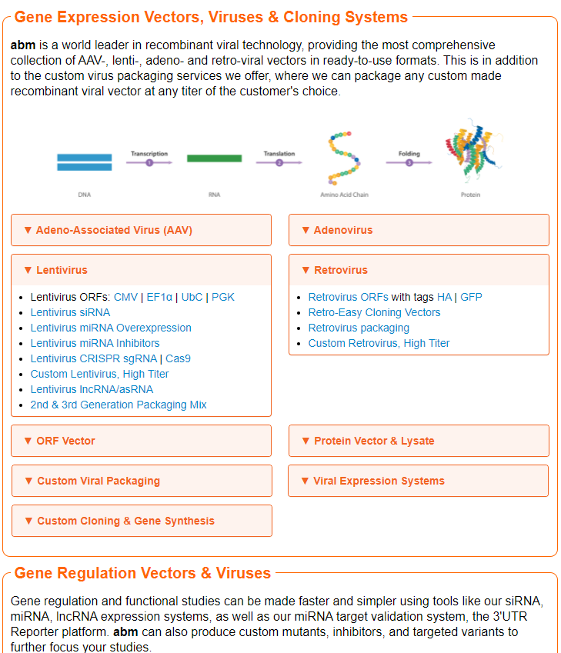
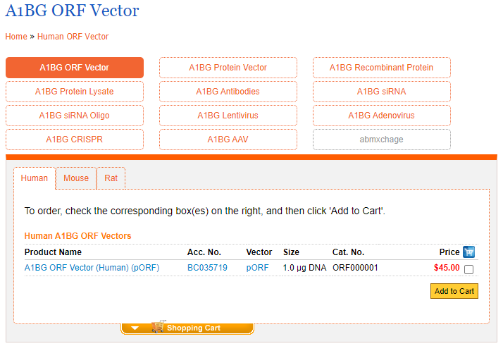
Home Page & Cross listing
https://old.abmgood.com/A1BG-ORF-Vector-A1BG.html
https://old.abmgood.com/Vectors.html
Notes:
Key features:
See at a glance on the Vector Library homepage what products we have, with the option to click in to the topic of interest to find out more information/products.
Cross listing products. Search for A1BG ORF, easily be able to switch between species and the different viral systems and product types we have for that gene (upsell other items as well).

Slide 12
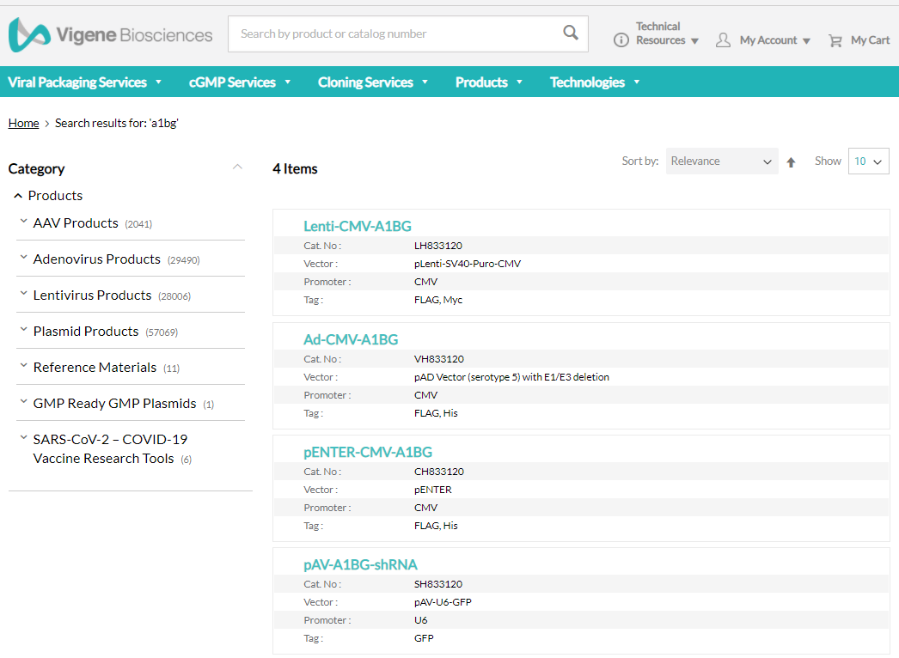
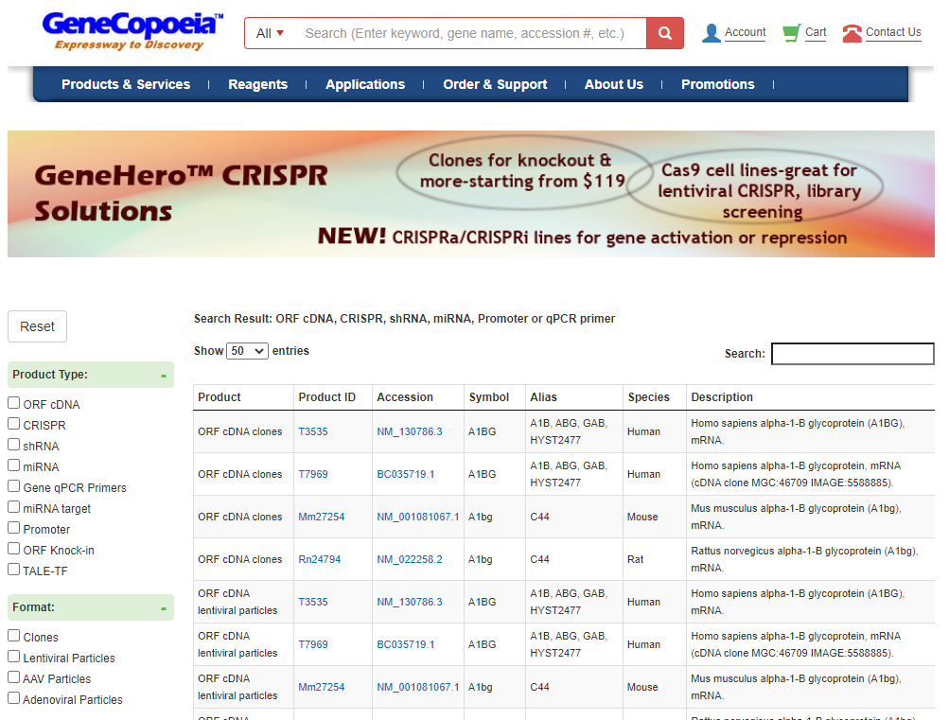
Search Results
https://www.vigenebio.com/catalogsearch/result/?q=a1bg
https://www.genecopoeia.com/product/search3/?s=a1bg&search_type=1
Notes:
Key Feature: Easy and clean search, can search the gene name and cleanly see what systems/vectors/virus systems are available.

Slide 13
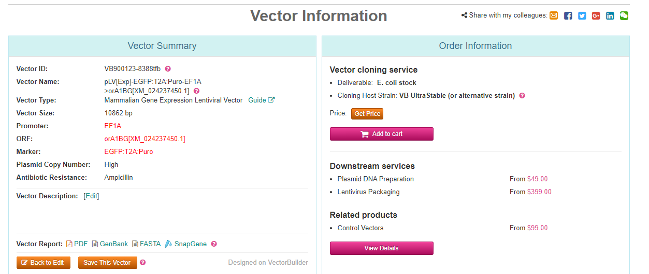
Default Product + Options
https://en.vectorbuilder.com/vector/VB900123-8388tfb.html
Notes:
Key feature: Being able to see a single main vector product, plus all the add-ons like “Add GFP”, “Change Promoter”, “Change vector backbone”, “Virus packaging”.

Slide 14
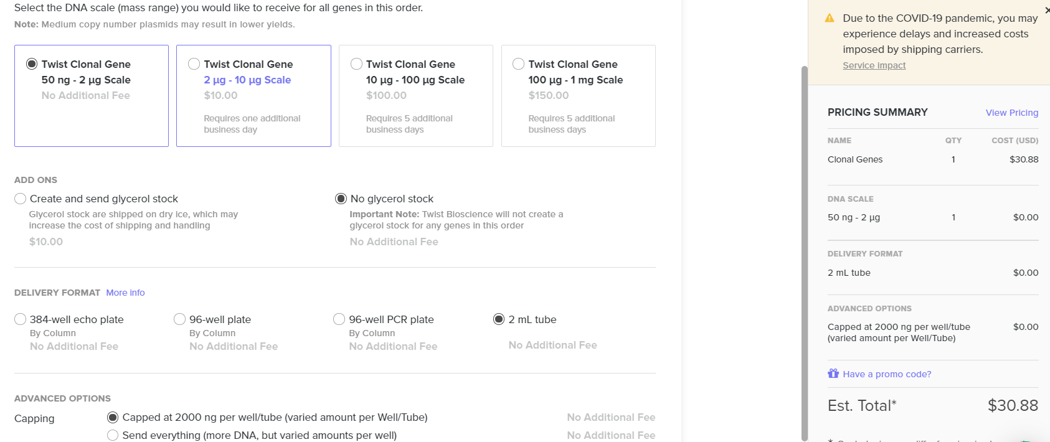
Another option layout
https://www.twistbioscience.com/ (logged-in ordering system interface)
Notes:
Key feature: Easy select desired delivery format (1ug DNA, maxiprep, glycerol stock, virus packaging, stable cell line)

Slide 15
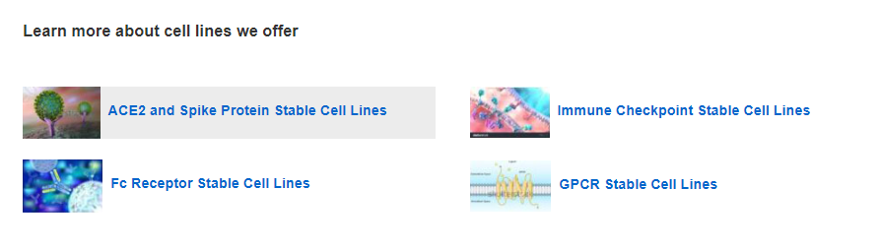
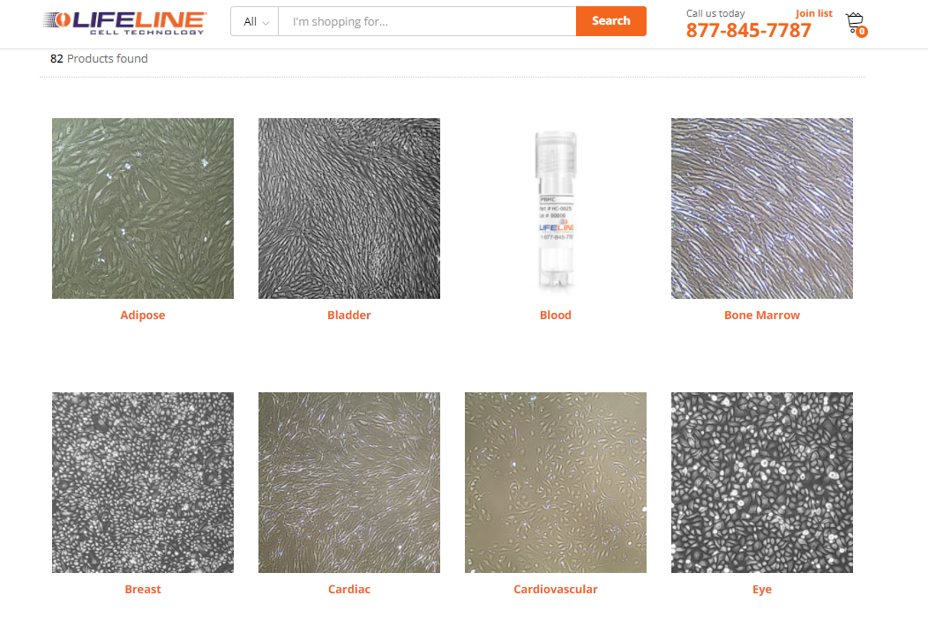
Ex website: Cell Biology
https://www.genscript.com/cell_lines.html?src=pullmenu
https://www.lifelinecelltech.com/product-category/tissue-type/
Notes:
https://www.cellapplications.com/

Slide 16
Growth Factors/Cytokines (Cell Biology)
Cell Biology
Growth Factors/ Cytokines
By Family
By Species
By System
EGF
FGF
IL
IFN
etc...
Human
Mouse
Rat
HEK293
E. coli
Insect
CHO
Can have full list of products, filter by Family, Species, System to get to the final product, like RNDsystems does.
Final product page has size selection option
https://www.peprotech.com/en/growth-factors-cytokines
https://www.rndsystems.com/products/rd-systems-cytokines-growth-factors
Other companies: Reprokine and Prospec

Slide 17
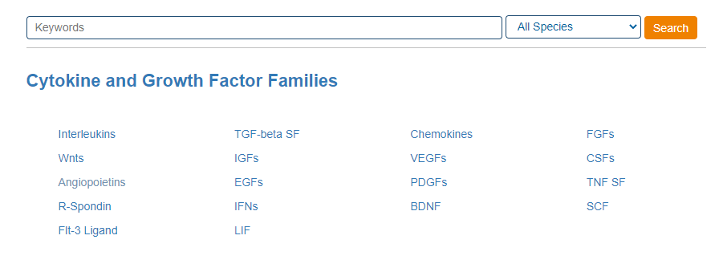
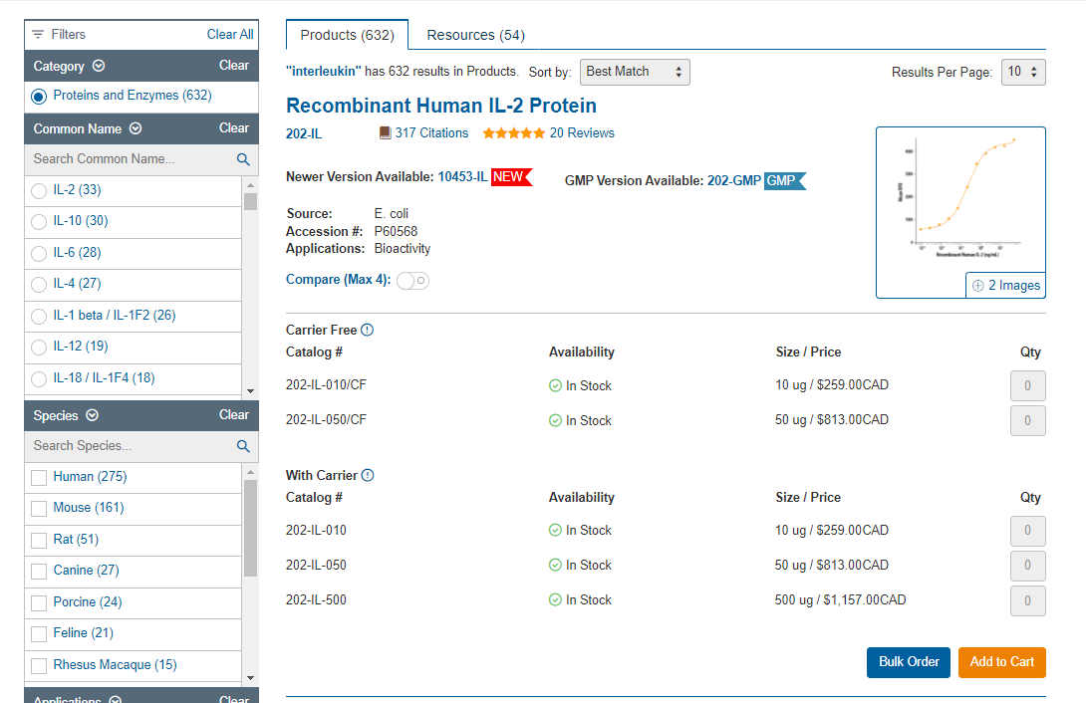
Ex website: GF
https://www.rndsystems.com/products/rd-systems-cytokines-growth-factors
Notes:
https://www.cellapplications.com/

Slide 18
Antibody
*Cross-List*
Antibody
By Gene
(2000)
Primary Antibody
HRP, AP…
Fluorescein
Secondary Antibody
His, HA,
GST, FLAG...
Tag Antibody
https://www.abcam.com/
Notes:
https://www.cellapplications.com/

